Slide 1
BUSINESS STRATEGY
GST Marketing Plan
GST Certification
Thing
To Do
Primary Goal
Scheduler Proposal
Planing & Excution
Thing To Know

Slide 2
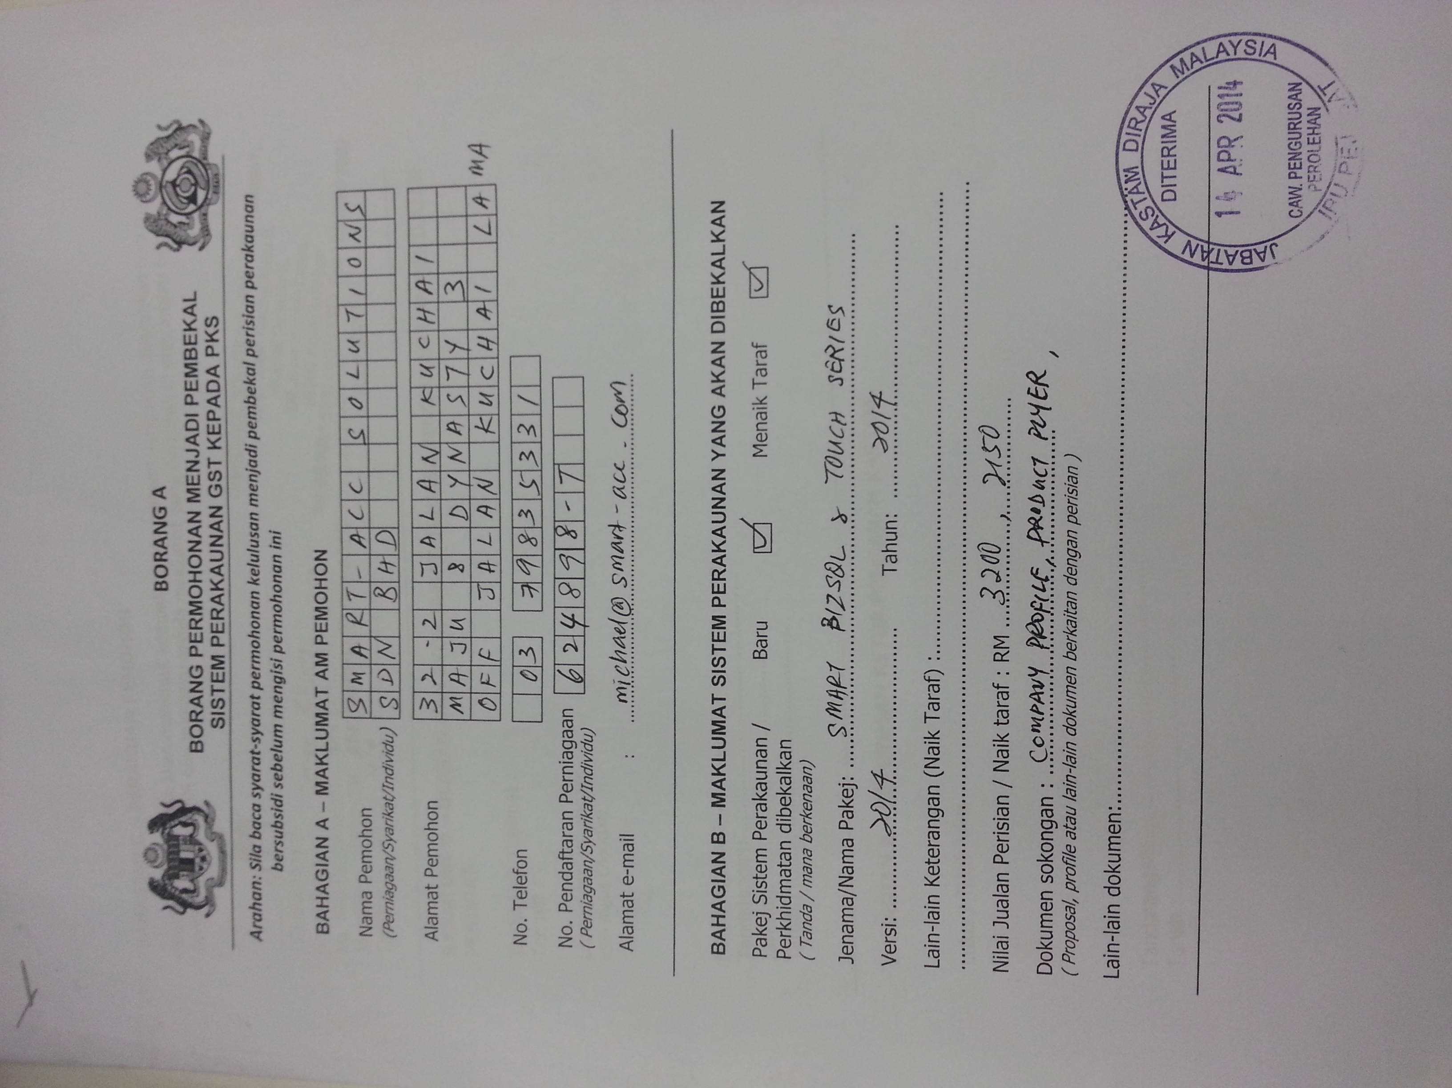
BUSINESS STRATEGY
GST Certification
Apr
May
Jun
Submitted
Demo to Unit GST
GST Certificate
DONE
Submit Dealer List to Unit GST
Advance Status

Slide 3
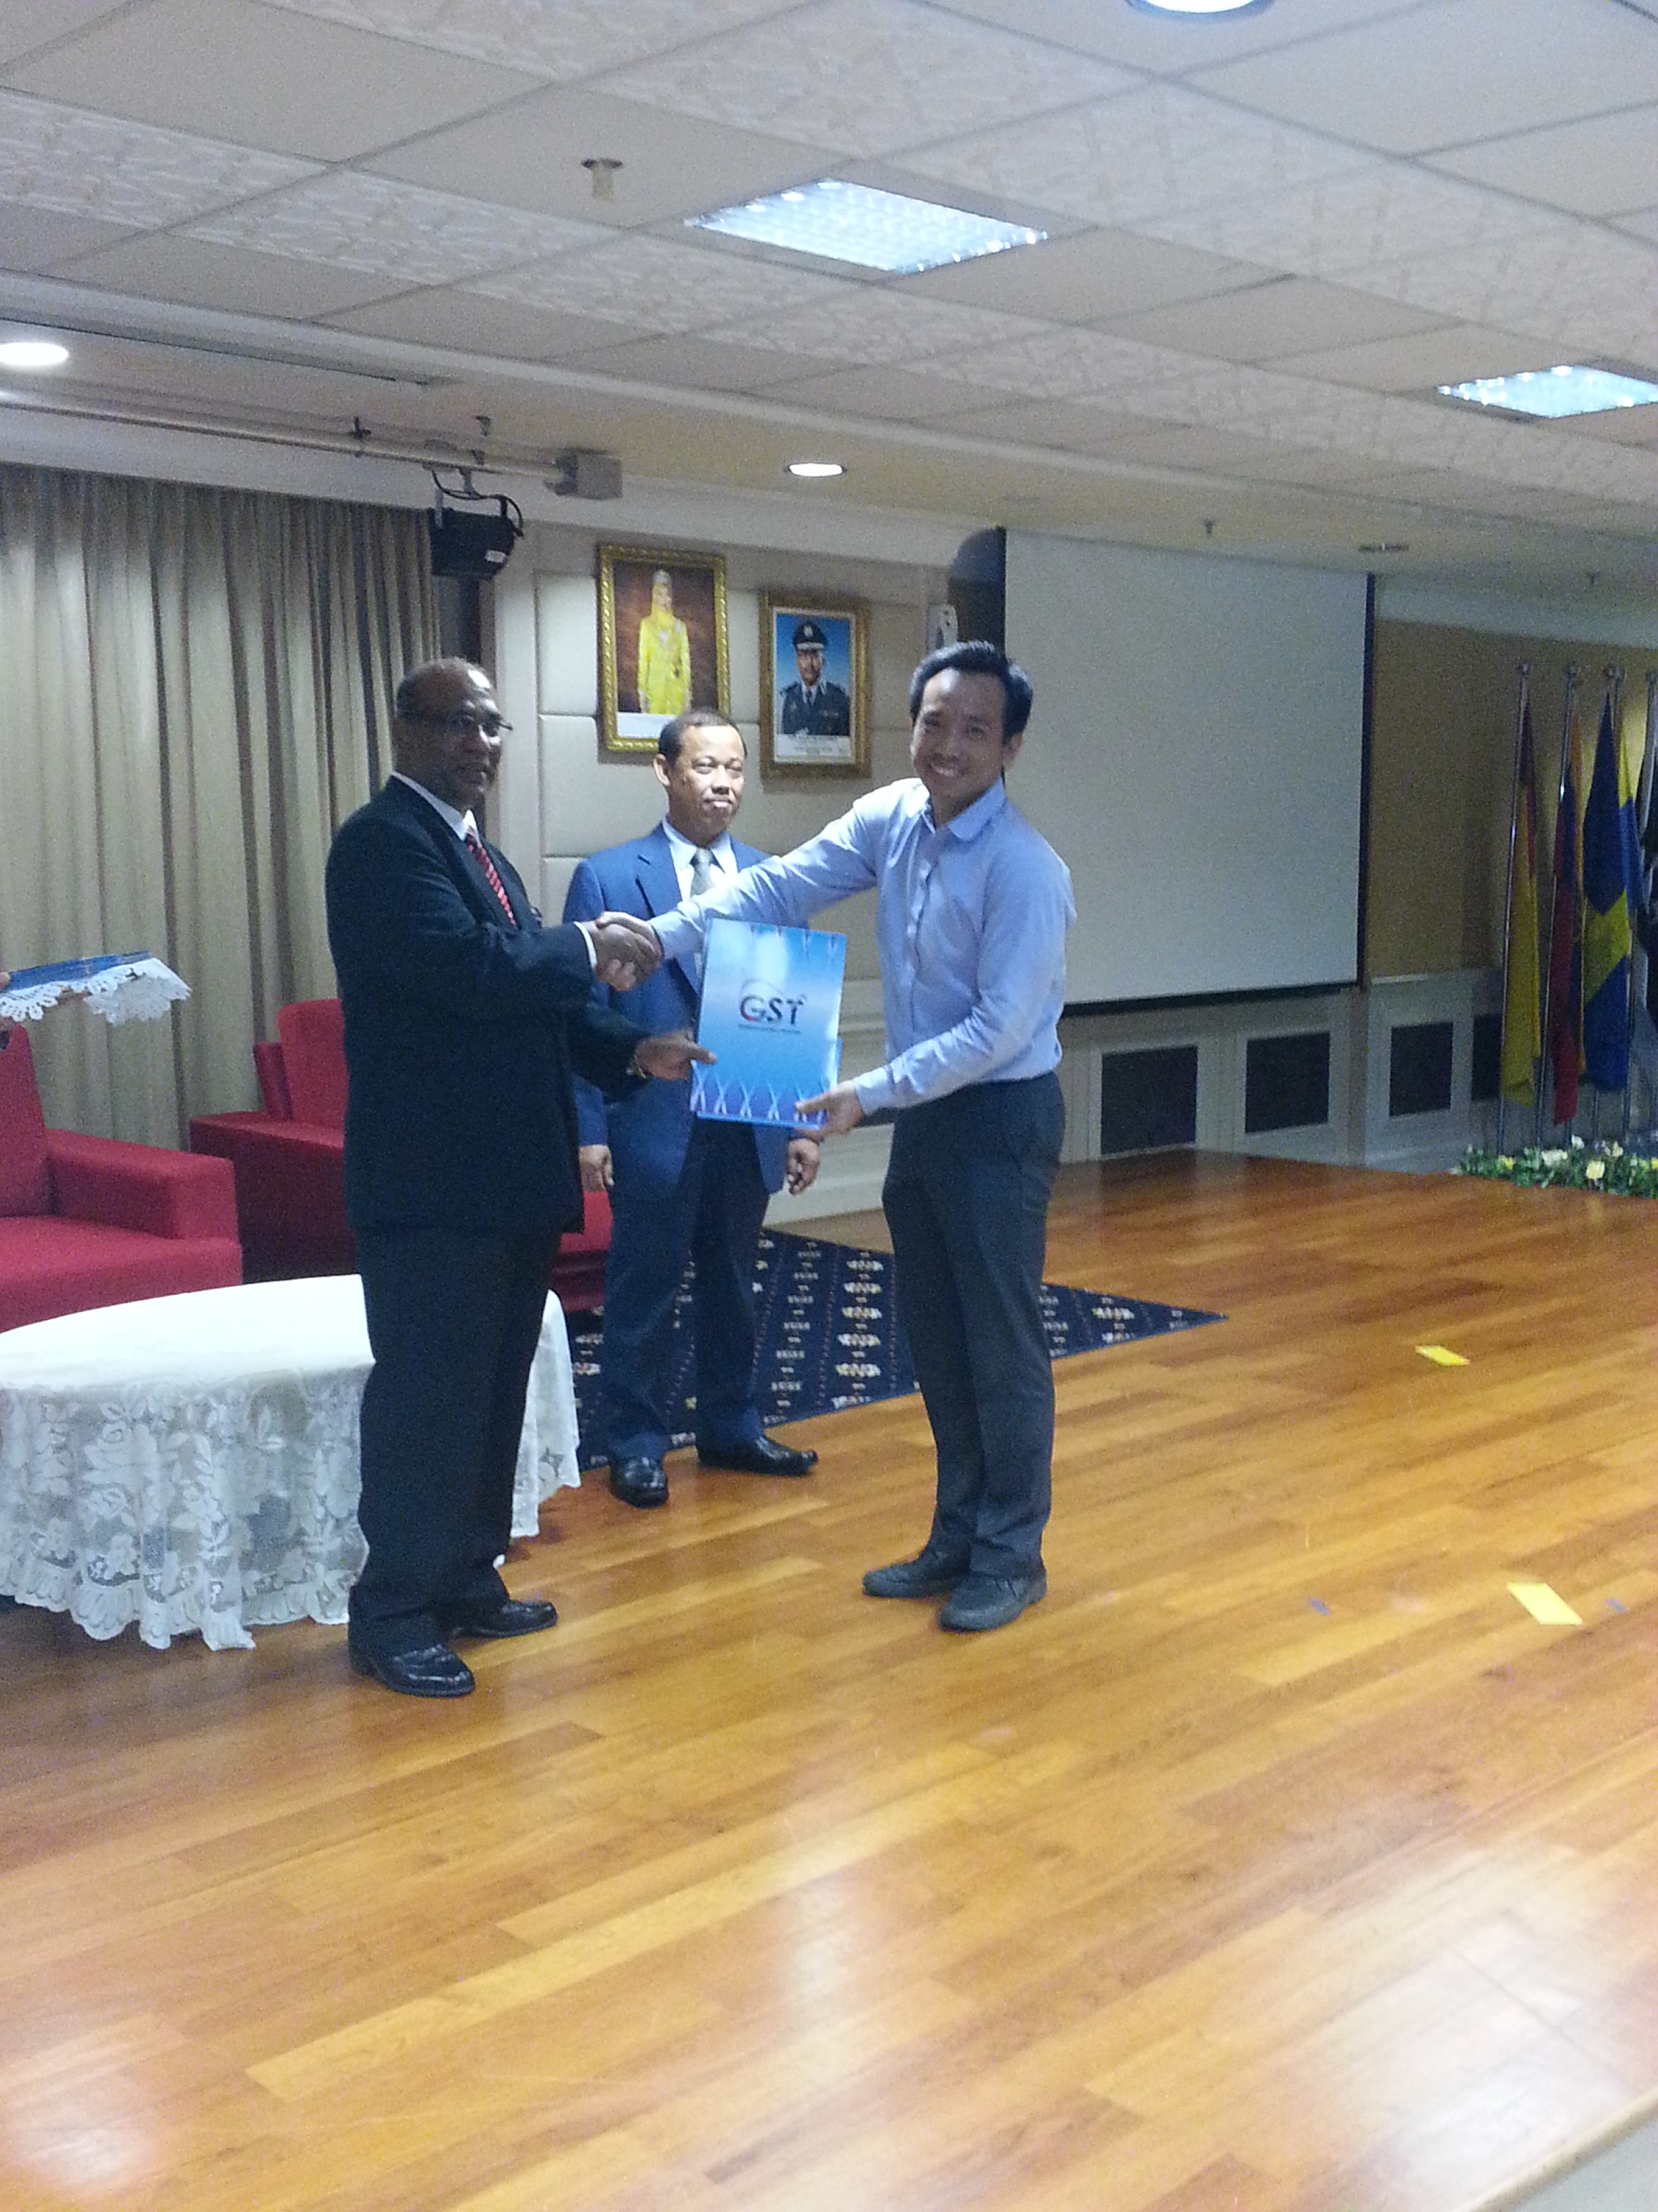
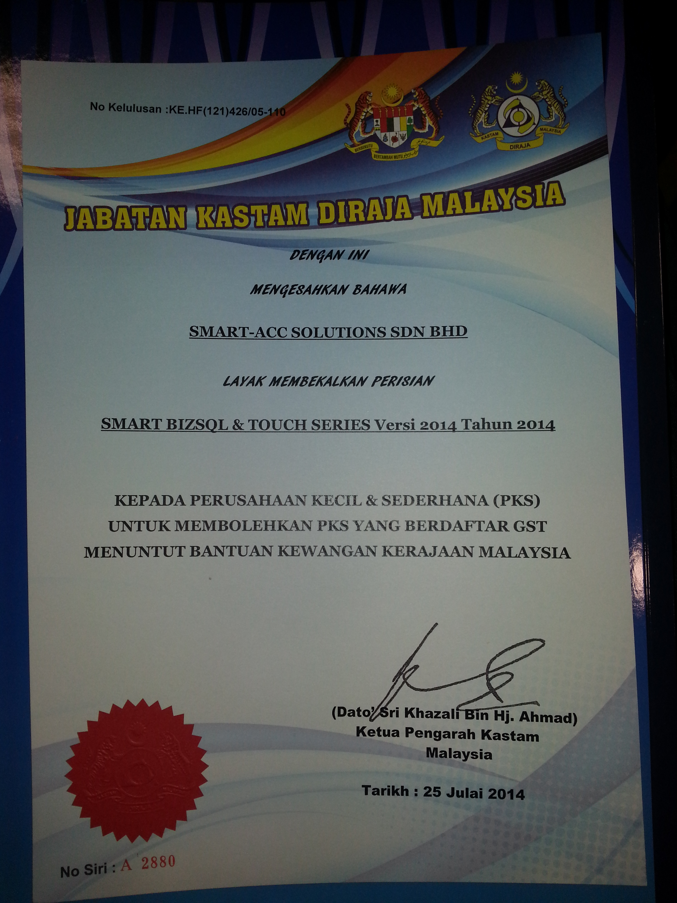
BUSINESS STRATEGY
GST Certification
AUG

Slide 4
BUSINESS STRATEGY
GST Marketing Plan
Primary Goal
GST Compliance
Smoothly the Business Operation Flow when GST was implmented
Strategy & Implementation
1. Proper Planning on Implementation
2. GST Compliance Checking
Business Readiness for GST Impact
1. Changing Business Operation
2. Consult with GST Consultant
GST Compliance

Slide 5
BUSINESS STRATEGY
GST Marketing Plan
Missions and Goals
GST Compliance
Strategic planning
Knowledge & Guide line
Implementation
Plan & Execution
Distribution Partner
1. Attend GST Seminar
2. Consult GST Consultant
Smart to assist
1. Attend GST Seminar
2. Consult GST Consultant
DP to assist
End User

Slide 6
BUSINESS STRATEGY
Thing To Do
Client Base
Set Priority
Identifying your customer group
Corporate Group > 10 outlets
SME > 3 outlets
Standalone
With Serial Number
AUG – NOV 2014
1. Corporate Group
> 10 outlets
2. With Serial Number
DEC 14 – MAR 15
3. SME > 3 outlets
4. Standalone

Slide 7
Goods And Services Tax (GST)
FRAMEWORK & IMPLEMENTATION
SIMON NGAN (012-3266499)
K. S. HOO TAXATION SERVICES SDN. BHD.

Slide 8
Outline -
Overview of GST
Type, time, place and value of supply
Input tax credit
Registration requirement and compliance
Tax invoice
Adjustment in GST
Transitional Rules
Special Schemes available
GST return and record Keeping
Business preparation

Slide 9
BUSINESS STRATEGY
Thank You
GST Compliance Completed

